Slide 1
CSE / T / 423C Distributed Computing Topic 6: Virtualization
Sarbani Roy
Department of Computer Science & Engineering
Jadavpur University E-mail: sarbani.roy@jadavpuruniversity.in
Room: CC-5-7
Phone: 9051639328

Slide 2
Cloud…virtualization
The cloud is a virtualization of resources that maintains and manages itself.
On-demand service : User not worried about maintenance and setup issues etc.
Networked Shared Resources : Large capacity distributed/multiplexed over several users
Flexible Provisioning : Dynamically scale resources
Fine-grained metering : pay-as-you-use model

Slide 3
What is required?
By Cloud Provider
Fast scalability – Quick addition and removal of servers
Service to customers should not be denied.
SLA should not be Violated
Efficient Resource Utilization

Slide 4
Virtualization
Wikipedia says “Virtualization, in computing, is the creation of a virtual (rather than actual) version of something, such as a hardware platform, operating system, a storage device or network resources”
Concept is not new…
Multi Programming – Each Process thinks it has complete control on all of the resources.
Virtual Memory
CPU Sharing

Slide 5
Virtualization
Virtual workspaces:
An abstraction of an execution environment that can be made dynamically available to authorized clients by using well-defined protocols,
Resource quota (e.g. CPU, memory share),
Software configuration (e.g. O/S, provided services).
Implement on Virtual Machines (VMs):
Abstraction of a physical host machine,
Hypervisor intercepts and emulates instructions from VMs, and allows management of VMs,
VMWare, Xen, etc.
Provide infrastructure API:
Plug-ins to hardware/support structures

Slide 6
Comparisons
Multiprogramming
Virtualization
CPU is shared among processes.
Memory is shared using Page Tables.
Process knows it is being managed- uses system calls.
CPU is shared among OSs.
Memory is shared using more level of indirections… Multiple Page tables.
OS may or may not know that it is being managed

Slide 7
Virtualization
In computing, virtualization is a broad term that refers to the abstraction of computer resources.
Desktop Virtualization
Server Virtualization
Network Virtualization
Storage Virtualization
Application Virtualization

Slide 8


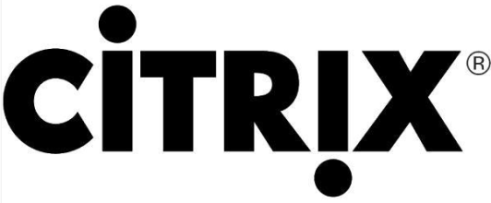
Vendors of Virtualization

Slide 9
Benefits from Virtualization
Save money and energy
Simplify management

Slide 10
Desktop Virtualization
VMware Workstation (Local)
Microsoft Virtual PC (Local)
Citrix XenDesktop (Centralized)

Slide 11
Desktop Virtualization Architecture
V i r t u a l
Applications
Applications
Applications
Guest OS (Windows)
Guest OS (Linux)
Guest OS (VMware ESX)
Virtual Machine
Virtual Machine
Virtual Machine
P h y s i c a l
Virtual Machine Manager
Host OS
Hardware

Slide 12
Components of Virtual Machines?
Configuration file
Hard disk file(s)
Virtual machine state file
In-memory file

Slide 13
Server Virtualization
Software (SoftV)
Hardware (HardV)

Slide 14
SoftV Server Virtualization
VMware Server

Slide 15
SoftV Server Virtualization Architecture
V i r t u a l
Applications
Applications
Applications
Guest OS (Windows)
Guest OS (Linux)
Guest OS (VMware ESX)
Virtual Machine
Virtual Machine
Virtual Machine
P h y s i c a l
Virtual Machine Manager(Server Products)
Host OS(Server Products)
Hardware

Slide 16
HardV Server Virtualization
Microsoft Virtual Server
Citrix XenServer

Slide 17
HardV Server Virtualization Architecture
V i r t u a l
Applications
Applications
Guest OS (Windows)
Guest OS (Linux)
Virtual Machine
Virtual Machine
Host OS
Virtualization Layer
P h y s i c a l
Hardware

Slide 18
HardV Server Virtualization Architecture
Applications
Applications
Applications
V i r t u a l
Guest OS (Windows)
Guest OS (Linux)
Guest OS (VMware ESX)
Virtual Machine
Virtual Machine
Virtual Machine
Host OS + Virtualization Layer
P h y s i c a l
Hardware

Slide 19
HardV Server Virtualization Architecture
Applications
Applications
Applications
V i r t u a l
Guest OS (Windows)
Guest OS (Linux)
Guest OS (VMware ESX)
Virtual Machine
Virtual Machine
Virtual Machine
Virtualization Layer (Hypervisor)
P h y s i c a l
Hardware

Slide 20
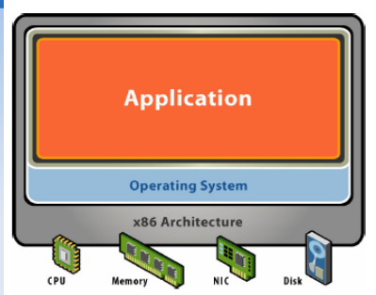
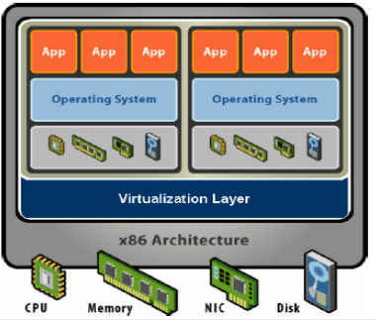
Physical vs. Virtual Machine
Single OS
h/w + s/w tightly coupled
Application crashes affect all
Resource under-utilization
Machine view to OS is independent of hardware
Multiple OS (isolated apps)
Safely multiplex resources across VMs

Slide 21
What is a hypervisor?
A hypervisor, also called a virtual machine manager (VMM), is a program that allows multiple operating systems to share a single hardware host. Each operating system appears to have the host's processor, memory, and other resources all to itself.
However, the hypervisor is actually controlling the host processor and resources, allocating what is needed to each operating system in turn and making sure that the guest operating systems (called virtual machines) cannot disrupt each other.

Slide 22

Server Consolidation using Virtualization
What happen if the two applications need two different platform?
How to charge for the resources being consumed by the applications?
How to secure the applications from each other?
Guest OS
Guest OS
Applications
Virtualized
Hardware
Virtualized
Hardware
Virtual Machine
Virtual Machine
Virtual Machine Monitor
(Hypervisor)
Host Operating System
Physical
Hardware

Slide 23
Key Technology: Virtualization
OS assumes complete control of the underlying hardware.
Virtualization architecture provides this illusion through a hypervisor.
Hypervisor is a software layer which:
Allows multiple Guest OS (Virtual Machines) to run simultaneously on a single physical host
Provides hardware abstraction to the running Guest OSs and efficiently multiplexes underlying hardware resources.
App
App
App
App
App
App
Operating System
OS
OS
OS
Hardware
Hypervisor
Traditional Stack
Hardware
Virtualized Stack

Slide 24
Virtual Machines
VM technology allows multiple virtual machines to run on a single physical machine.
App
App
App
App
App
Xen
Guest OS
(Linux)
Guest OS
(NetBSD)
Guest OS
(Windows)
VMWare
VM
VM
VM
Virtual Machine Monitor (VMM) / Hypervisor
UML
Denali
Hardware
etc.
Performance: Para-virtualization (e.g. Xen) is very close to raw physical performance!

Slide 25
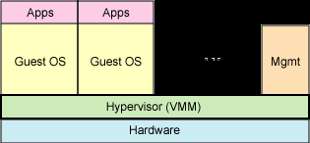
Native and Full Virtualization
The virtual machine simulates enough hardware to allow an unmodified "guest" OS (one designed for the same CPU) to be run in isolation.
Examples:
VirtualBox
Virtual PC
Vmware
QEMU
Win4Lin
XEN/Virtual Iron

Slide 26
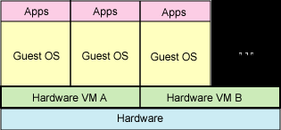
Hardware enabled virtualization
The virtual machine has its own hardware and allows a guest OS to be run in isolation.
Intel VT (IVT)‏
AMD virtualization (AMD-V)‏
Examples:
VMware Fusion
Parallels Desktop for Mac
Parallels Workstation

Slide 27
Partial virtualization
The virtual machine simulates multiple instances of much (but not all) of an underlying hardware environment, particularly address spaces.

Slide 28
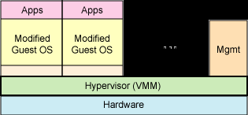
Paravirtualization
The virtual machine does not necessarily simulate hardware, but instead (or in addition) offers a special API that can only be used by modifying the "guest" OS.
Terminologies
Hypervisor, hypercall
Examples:
XEN, KVM, Win4Lin 9x

Slide 29
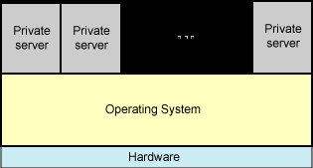
Operating system-level virtualization
Virtualizing a physical server at the operating system level, enabling multiple isolated and secure virtualized servers to run on a single physical server.
Examples:
Parallels Workstation
Linux-VServer, Virtuozzo
OpenVZ, Solaris Containers
FreeBSD Jails
Chroot ?

Slide 30
Application Virtualization
Typically for the purpose allowing application binaries to be portably run on many different computer architectures and operating systems.
http://en.wikipedia.org/wiki/Comparison_of_Application_Virtual_Machines
Examples:
.NET CLR
JVM
Script Languages: Python, Ruby, Javascript...

Slide 31
Requirement for Virtualizability
Popek and Goldberg [1974 paper] mentioned a set of requirements that must be met.
They divided instructions into three categories:
Privileged instructions: execute in a privileged mode, but will trap otherwise.
Control sensitive instructions: attempt to change the config of resources
Behavior sensitive instructions: are those that behave in a different way depending on the config of resources
They said that all sensitive instructions must also be privileged instructions.
Hypervisor must be able to intercept any instructions that changes the state of the machine in a way that impacts other processes.

Slide 32
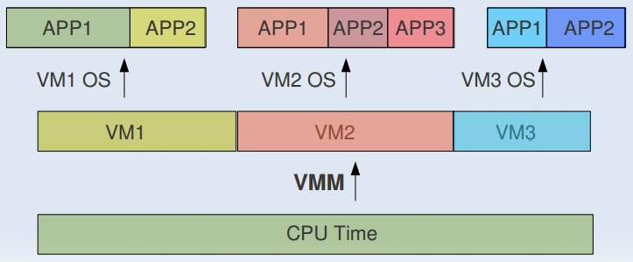
CPU Sharing
VMM or Hypervisor provides a virtual view of CPU to VMs.
In multi processing, CPU is allotted to the different processes in form of time slices by the OS.
Similarly VMM or Hypervisor allots CPU to different VMs.

Slide 33
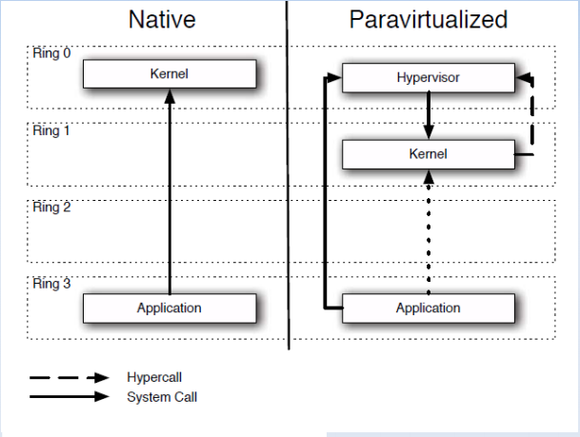
XEN Hypercall

Slide 34
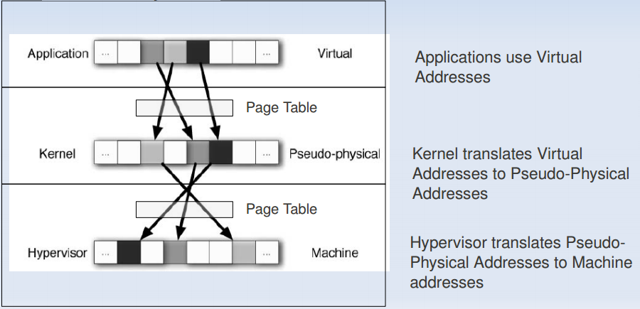
Memory sharing
In Multiprogramming there is a single level of indirection maintained by Kernel.
In case of Virtual Machines there is one more level of indirection maintained by VMM

Slide 35
IO Sharing
DMA Problem
Device needs to use Physical Memory location.
In a virtualized environment, the kernel is running in a hypervisor provided virtual address space
Allowing the guest kernel to convey an arbitrary location to device for writing is a serious security hole
Detecting a DMA instruction is nontrivial. Each device defines its own protocol for talking to drivers.
XEN Follows Split Driver Model: Dom 0 does the IO on behalf of all the other guests.
As DOM0 is privileged the IO has no problem

Slide 36
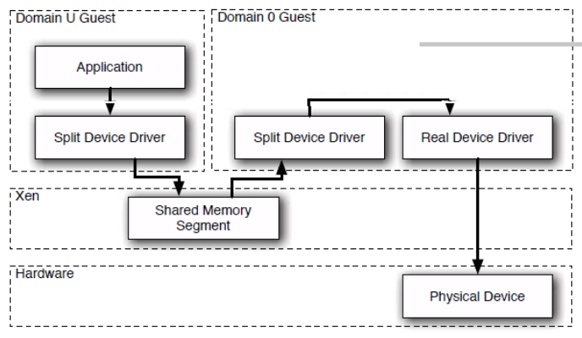
XEN IO Split Device Driver

Slide 37
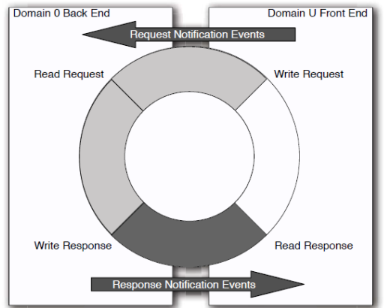
IO Ring
Shared memory is used with event based synchronization

Slide 38
Types of Virtualization
Based on the position of the hypervisor
Type 1 (bare-metal)
Has complete control over hardware.
Need to replicate the functionality of an OS
Type 2 (hosted)
Hypervisor is lightweight but need to fight with OS for a resource.
Can run native process directly without any VM.
Easy management
check how much CPU and memory is consumed by a VM
spot a VM forcefully kill it.
However it is slow due to two level translation.
Type 2 (hosted)
Type 1 (bare-metal)
VM1
VM2
Guest
Process
Hypervisor
Guest
VM1
VM2
OS
Host
Hypervisor
Host
Hardware
Hardware
VMware Workstation, Microsoft Virtual PC, Sun VirtualBox, QEMU, KVM
VMware ESX, Microsoft Hyper-V, Xen

Slide 39
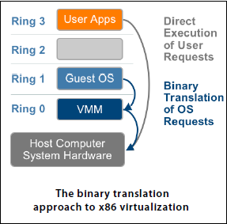
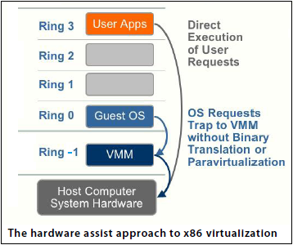
Types of Virtualization
Based on the way the VM executes its instructions
Full Virtualization based on Binary Translation:
Hypervisor runs at Ring 0, Guest OS runs at Ring 1
while VM apps run at Ring 3
VM apps run directly on hardware while System
Calls ( for privileged and sensitive instructions ) will be
trapped to the hypervisor which will emulates the
behavior of those instructions (binary translation).
Clearly Guest OS need not be modified
Poor performance due to binary translation.
Hardware-assisted Full Virtualization:
Intel VT and AMD V technology add a new privilege
level (Ring -1) to the CPU
Hypervisor runs at Ring -1 that allows the Guest OS
to run at Ring 0.
Hardware now detects the privileged and sensitive
Instructions and traps them to the hypervisor.
Ring -1 privilege level allows the hypervisor to safely
and transparently use direct execution of those trapped
instructions
Notes:
Hardware assisted Full virtualization is also slow due to huge context switch between privilege levels.

Slide 40
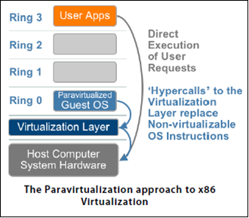
Types of Virtualization
Based on the way the VM executes its instructions
Para-virtualization:
Para-virtualization attempts to reduce the virtualization overhead by modifying the Guest OS kernel.
It replaces the nonvirtualizable OS instructions by hypercalls
Both the Para-virtualized Guest OS and the Virtualization layer runs at Ring 0 thus reducing the need to context switch for hypercalls.

Slide 41
Virtual Machine Migration
Virtual Machines are just software or more specifically can be considered as files.
Clearly moving a VM from one physical system to another is not a tough job. This process of moving a VM from one physical system to another is called VM Migration.
Static VM migration is easy.
Stop the VM, copy the file system to the desired PM and restart the VM
Dynamic VM migration needs careful design for efficient migration.
Capture and copy the entire state of VM as a snapshot in time.
The snapshot includes process and memory state as well as virtual resources such as BIOS, devices, MAC address etc.

Slide 42
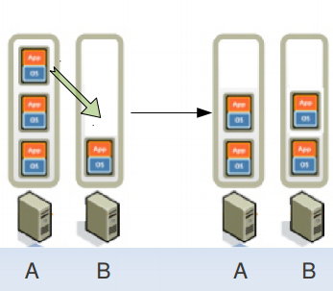
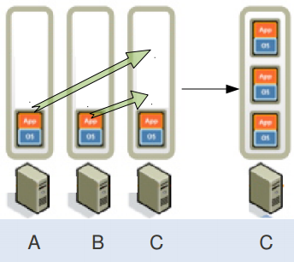
Benefits
Load Balancing ­ Better Response time
Consolidation ­Reduces number of Physical Machine requirement

Slide 43



Successful Cloud Models
Amazon Cloud
Google Cloud
Development SDK
Internet
Provisioning Services
VM
VM
VM
Application Deployment & Distributed Execution Platform
VM
VM
VM
VM
VM
VM
Simple DB
Simple Queue
Google Datastore
S3 – Simple Storage
Map Reduce
Big table

Slide 44

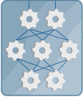
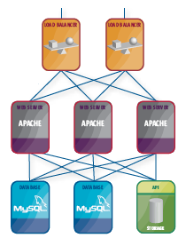
Programming the IaaS Cloud
Application is composable and Infrastructure is programmable.
Deployed
Application
Library
Composed
Application
Selection
Programming
Notes:
Costs for the delivery of services agility of the deployed services.
From one perspective, cloud computing is nothing new because it uses approaches, concepts, and best practices
that have already been established. From another perspective, everything is new because cloud computing changes how we invent, develop, deploy, scale, update, maintain, and pay for applications and the infrastructure on which they run.

Slide 45
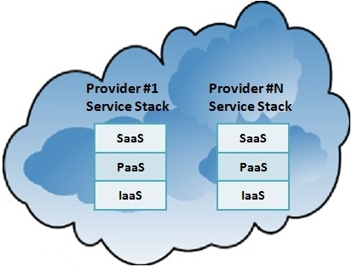









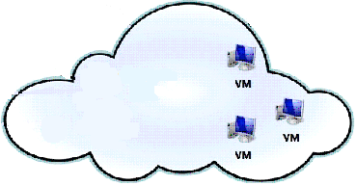


Application-centric VM Management
Event
Alert Messages
Notes:
Before going to discuss about the Application centric cloud architecture let us define an “Application” formally so that the architecture can support heterogeneous application formats.
Every application consists of a number of tiers (T) (even a standalone application can also be considered to be based on a single tier). Every tier uses specific resources (R) in order to implement the functionality of that tier (e.g. a database tier may use MySQL manager nodes and nbdb nodes as its resources).
U and P are the users and policy that define the SLA for the application.
The most important part of the application is the monitoring subsystem M that define the self-service and agility feature of the cloud application. M can be defined as a quadruple having two important entities namely events(E) and workflows(W). Events define what happens to the deployed application and workflow defines what to do at a certain event. Examples of events can be cited with server died, service died, a tier overloaded or under loaded etc. A workflow is a sequence of heterogeneous actions performed by the monitoring subsystem to fine tune the resources for an application at the occurrence of a specific event. Workflow may also be complex where one workflow kicks off (initiates) other workflows, either synchronously or
asynchronously, for achieving the final goal. It also defines two mappings: Event Mapping - Em and Workflow Mapping- Wm. Em can be defined at the resource level or the tier level. For example, tier overloaded or under loaded events should be defined at the tier level whereas server died or service died should be defined at the resource level. Wm defines the relationships among events and workflows that allow the monitoring subsystem to kick off specific workflows at a particular event.

Slide 46
Using Amazon Virtual Machines
Amazon VM(Instance) purchasing model
On Demand Instance
Use Instance whenever you use without any long term commitment.
No upfront pay. Pay only per hour basis.
Instances may not be granted immediately due to unavailability of physical capacity.
Reserved Instance
Reserve Instance with some upfront payment and get significant discount on hourly charge.
Instances are guaranteed to be granted immediately
Spot Instance
On Demand Instance without fixed hourly charge.
User need to define the upper limit on hourly charge(bid) so that Spot Instances are available only when the current spot price is below the bid
Price per hour is decided based on availability and demand.
Notes:
The key part of the architecture is the event generation because a wrongly generated even may lead to costly deployment of the application.
An event is the change of state of the application from one defined state to other. An application can be in any of the six defined states namely new, inactive, active, unbalanced, unreachable and terminated.
Whenever you have completed the programming aspects of the application along with the required data your application is in the new state. Once you map such an application to the various modules according the formal definition your application is in the inactive state. In the inactive state your application is composed, the required infrastructure is programmed and is ready to deployed within the cloud. The application in inactive state will take only a few minutes to be deployed in the cloud. Once your application is deployed and ready to be accessed via the corresponding URL your application is in the active state and the monitoring subsystem measures the deployed application based on the event generation schemes to be described later. In the active state you have to pay for the cloud resources. If you don’t want to use your application for a while to save money, you can undeploy and redeploy again at latter time within minutes. You can redefine your application statically in the inactive state or dynamically in the active state to fine tune your application manually. Once you don’t want to use your application anymore you can release the mapping from the middleware and your application will be in the terminated state.
The two other important states of the application are the unbalanced and unreachable. Once your deployed application is overloaded or underused based on some threshold condition, your application will be in the unbalanced state. Similarly if any of the interested resource fails, your application will be in the unreachable state. In those states, either you can maintain or generate a workflow to heal the situation that will revert back your application to the active state or you can undeploy, redefine and redeploy your application manually.
Accordingly we have devised the following five event generation schemes namely threshold based, prediction based, request based, ping based and schedule based. Prediction and request based are the two variations of the threshold based event generation scheme. Prediction based event generation scheme may be useful for a long running healing workflow and the request based event generation scheme is useful to predict the load without measuring them. Ping based event generation helps to detect unreachable state and schedule based event generation scheme is used to generate asynchronous events.

Slide 47
Characteristics of Spot Instances
Spot instances are available when the user’s bid exceeds the current spot price
Spot instances are terminated (becomes unavailable) without any notification to the user whenever the current spot price exceeds the user’s bid. That’s why spot instances are unreliable in nature.
The price per instance-hour for a spot instance is set at the beginning of each instance-hour. Any change to the spot price will not be reflected until the next instance-hour begins.
Amazon will not charge the last partial hour if the spot instance is terminated due to out-of-bid situation. However Amazon will charge the full hour if the user terminate the instance forcefully.
Amazon provides the history of spot prices of a spot instance at a specific availability zone for the last 3 months free of cost.

